Slide 1
Lifelong Learning Journey
Toward
Artful Coaching Mastery
ICF WA State Chapter Eastside Satellite
SEP-DEC 2014
Edmonds WA & ConnectPro 9 | 2014

Slide 2
Introductions
What is your Coaching mindset?
Ease and comfort revealing complacency and habit?
What stretch will you risk to grow?
Into the territory of innovation and catalytic insight?
What are you here for?
Explore Skills and Methods to Develop Over Time?
Peer Learning & Deepening to Challenge You?

Slide 3
Potential…
…a combination of potis, able
plus esse, to be
to be able, to have authority and power to be effective in action.
Potential is a condition of having power that is potent and has not yet come into being
What stops us from naturally expressing our full potency?
The sweet spot that inspires!

Slide 4
Visible Above:
Results ~ Outcomes
Behaviors ~ Habits
Invisible Below:
Motivators ~ Biases
Personality ~ Beliefs
Essence ~ Values
Based upon the work of Carl Rogers, an American psychologist who developed the “person-centered approach” to understand personality and human relationships

Slide 5
Poll Question: What statement best describes the degree of potential you express as a coach?
I express my full potential 100% of the time when coaching
I express 75% of my full potential when coaching
I express 50% of my full potential when coaching
I express 35% or less of my full potential when coaching
My potential does not belong in a coaching session

Slide 6
Three Pillars: Generative Thriving
Engaging from Wholeness liberates
Coaching our relationship to emergence is generative
Revealing Essence strengthens Client Sovereignty

Slide 7
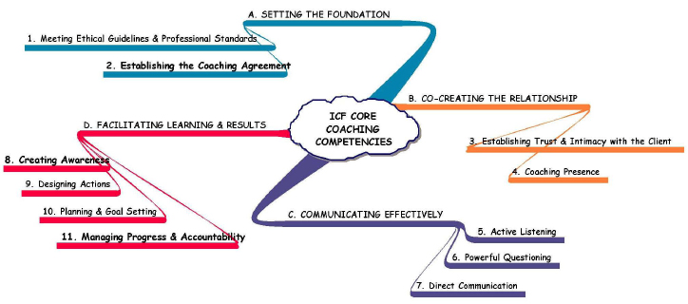
ICF Core Coaching Competencies

Slide 8
From Do-Have-Be… …To Be-Do-Have
BE
Essence
Core of my being; who I am; the unalterable ME
DO
Pathway
What I DO that ignites and inspires our Essence to express each moment
HAVE
A rich and fulfilling life
What I want!

Slide 9
Key to Quality of Life?
Living through the Authentic Self

Slide 10
Transformative
Coaching Purpose
Deepen The
Learning
Create and heighten client awareness of Essence so he or she will step confidently toward Personal Sovereignty
Forward
The Action

Slide 11
Definition of Sovereignty
Quality or authority of
being independent and in charge of choosing our relationship with the conditions of our lives.
When we take our life in our own hands we also take upon our self to act with integrity and response agility with…
Own Life ~ Family ~ Community
and with our Fellow Human Beings and our Planet as a Whole

Slide 12
Language Matters
Self reliant | Self congruence | Self acceptance
Self worth | Self love | Self respect
Self trust | Self responsibility | Self knowledge
Inner harmony | Personal freedom | Serenity
Personal choice | Inner authority | Author of my life
"Everything seems possible when I am in my personal sovereignty."

Slide 13
Generative Wholeness: Outcome of Transformative Coaching
The dynamic capacities to originate, create, learn and produce desired results while being free to express from Essence in any relationship
Deepen
The Learning
Forward
The Action

Slide 14
Coach Vision & Personal Essence
I am generative wholeness, liberator of potential, bold evocative coach
I am alchemical seer, black pearl luminescence, savvy sassy love, elegant imaginator, free generous spirit riding on the winds of joy

Slide 15
Professional Sovereignty
Choose your professional experience each moment so that you are a model of wholeness and demonstrate for your clients the positive impact of self-care, self-awareness and self-development.

Slide 16
Intention Statement: Definition
A tangible expression of emotional and physical, felt experience you most want.
Written in the first person, “I” voice and present tense, as if it is happening already in your experience.

Slide 17
Intention Statement: Examples
Professional Sovereignty
I recharge my well by powerful play and spontaneous spirit
Collaborators & Resources
I generously invite partnering that generates triple wins and pays forward every creative act

Slide 18
4Cs of professional presence™
Claim | I say it proudly that I am a professional coach, 100%
Communicate | I perceive, hear and express from the heart revealing my Essence and passion
Collaborate | I generate solutions that are client-driven and filled with reciprocal inspiration
Connect | I powerfully invite clients to engage based on mutual conditions of satisfaction

Slide 19
A Coach’s Tool Kit
Claim → Awareness Building
Communicate → Clarity Building
Collaborate → Alignment Building
Connect → Action & Results

Slide 20
Three Pillars: Generative Thriving
Engaging from Wholeness liberates
Coaching our relationship to emergence is generative
Revealing Essence strengthens Client Sovereignty

Slide 21
Practices ~ Methods ~ Tools
Self Reflection is Essential
Recordings: Recognizing & Evolving
Transcripts: Perceiving & Imagining
Experimenting: Learning Styles & Exaggeration
Engaging in Mentor Coaching & Coaching Supervision
Peer Triads: Coach-Client-Observer
Public Fishbowl Coaching
Self Assess & Development Plan

Slide 22
In Between Sessions
Personal Practice: Weekly
Self Reflection methods
Self Assess & Development Plan
Triad Practice: 3-6 Times
Record and apply personal practices

Slide 23
In Between Sessions
3 Inquiries: Journal & Share one per month with your peers
What stops me from naturally expressing my full potency?
What permission is required to embody wholeness, the freedom to express from Essence?
What am I harvesting now in my artful coaching mastery

Slide 24
Keep In Touch!
www.invitechange.com
Thank you!
Janet.Harvey@invitechange.com
Live Sovereign: Relationship Is A Courageous Act

